Slide 1
Capstone Engagement
Assessment, Analysis, and Hardening of a Vulnerable System

Slide 2
Table of Contents
This document contains the following sections:
01
Network Topology
02
Red Team: Security Assessment
03
Blue Team: Log Analysis and Attack Characterization
Hardening: Proposed Alarms and Mitigation Strategies
04

Slide 3
Network Topology
3

Slide 4
Network Topology
Network
Address Range: /24
Netmask:255.255.255.0
Gateway: 192.168.1.1
Machines
IPv4: 192.168.1.1
OS: Windows 10 Pro
Hostname: ML-RefVm-684427
IPv4: 192.168.1.90
OS: Kali Linux
Hostname: Kali
IPv4: 192.168.1.100
OS: Ubuntu
Hostname: ELK
IPv4: 192.168.1.105
OS: Ubuntu
Hostname: Capstone

Slide 5

Red Team
Security Assessment
5

Slide 6
Recon: Describing the Target
Nmap identified the following hosts on the network:
Hostname | IP Address | Role on Network
ML-RefVm-684427 | 192.168.1.1 | Hyper-V Host
Kali | 192.168.1.90 | Attacking Machine
ELK | 192.168.1.100 | ELK stack host
Capstone | 192.168.1.105 | Capstone Reporting Machine

Slide 7
Vulnerability Assessment
The assessment uncovered the following critical vulnerabilities in the target:
Vulnerability | Description | Impact
Apache Directory Listing CVE 2007 0450 | Allowed attackers to reveal the ip address and the secret folder | Allowed attackers to reveal the ip address and the secret folder
Local File Inclusion (LFI) CVE 2021 31783 | Allows Local File Inclusion because the file parameter is not validated with a proper regular-expression check | An LFI vulnerability allows attackers to upload malicious code that can be executed remotely on a site creating a backdoor
Brute Force Attack | An attack that allows you to systematically go through all combos of username and password | With this type of attack and a common password file sites can be hacked and passwords be found
Reverse Shell Backdoor CVE 2019 13386 | Allows to send a reverse shell payload on a web server while the firewalls do not detect the payload | Attackers gained the remote backdoor access to the Capstone web server

Slide 8
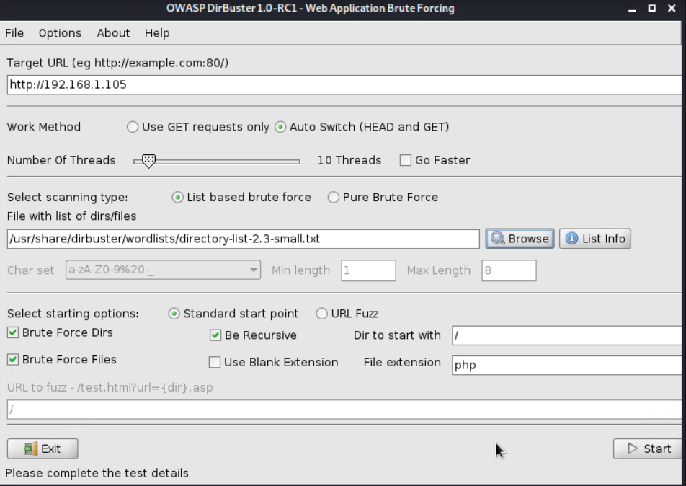
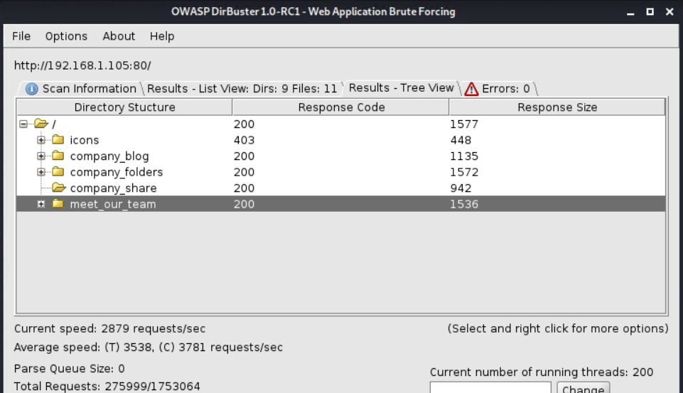
Exploitation: Apache Directory Listing
01
02
03
Tools & Processes
I used dirbuster to scan the target machine (192.168.1.105) to find all the directories on the server.
To speed up the attack, I used a wordlist supplied with the tool
Achievements
With this tool I got a full map of all the folders on the server and which folders were not visible from the standard web interface /corporate_files/secret_file

Slide 9
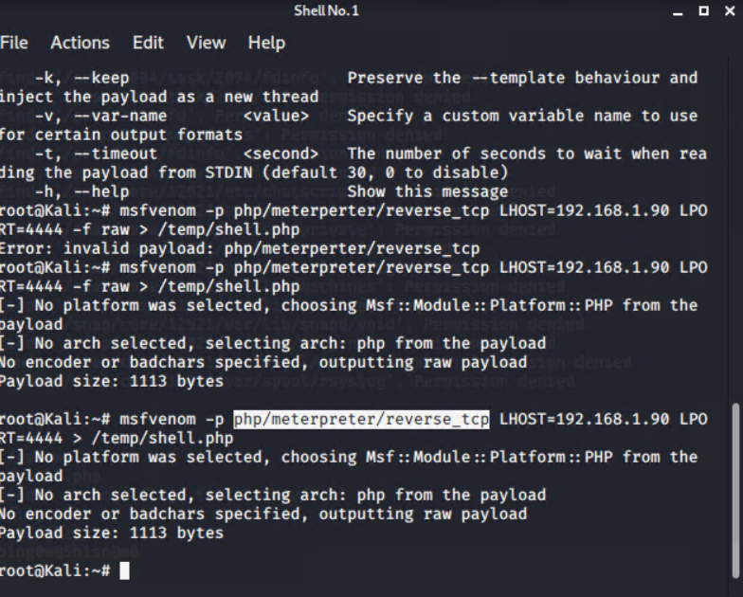
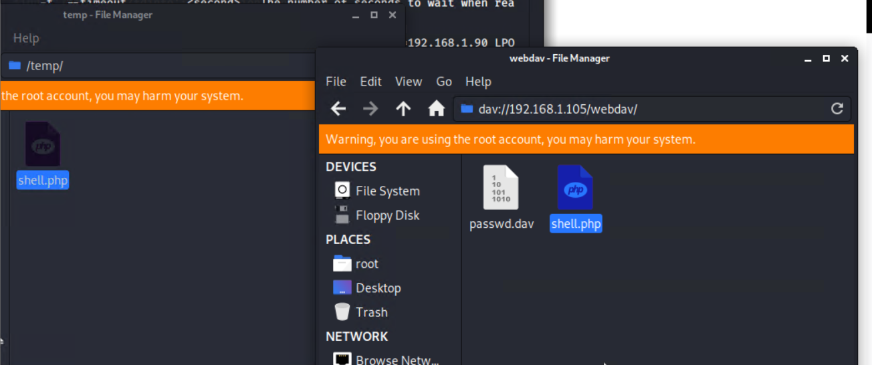
Exploitation: Local File Inclusion (LFI)
01
02
03
Tools & Processes
A PHP reverse shell payload
was created using
MSFvenom, and the Kali File Manager was used to drag
and drop the payload onto the victim web
server using credentials found on the server
and the
WebDAV protocol.
Achievements
What did the exploit achieve?
It allowed for the creation of a malicious payload to be upload to the server to allow for exploitation of the system
[INSERT: screenshot or command output illustrating the exploit.]

Slide 10
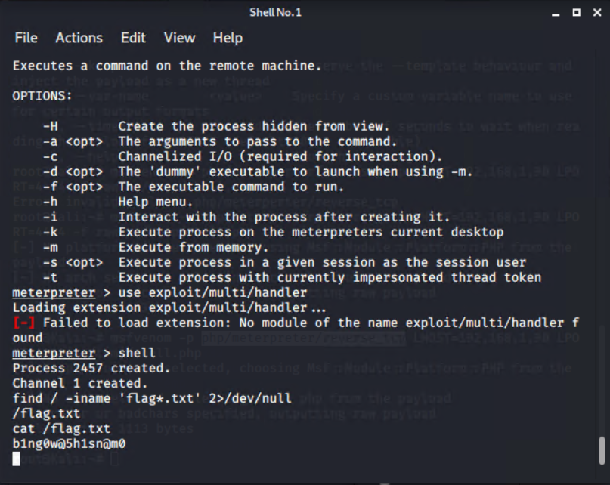
Exploitation: Reverse Shell Backdoor
01
02
03
Tools & Processes
Using the Metasploit toolset:
Established remote listener.
Executed reverse shell
backdoor on Capstone
Apache server.
Commands:
Meterpreter> use exploit/multi/handler
Meterpreter> set payload php/meterpreter/reverse_php
Meterpreter> exploit
Meterpreter> shell
Achievements
Using the payload created during the LFI exploit, I was able to achieve reverse shell access to the Capstone server and find the flag.txt
[INSERT: screenshot or command output illustrating the exploit.]

Slide 11

Blue Team
Log Analysis and Attack Characterization
11

Slide 12

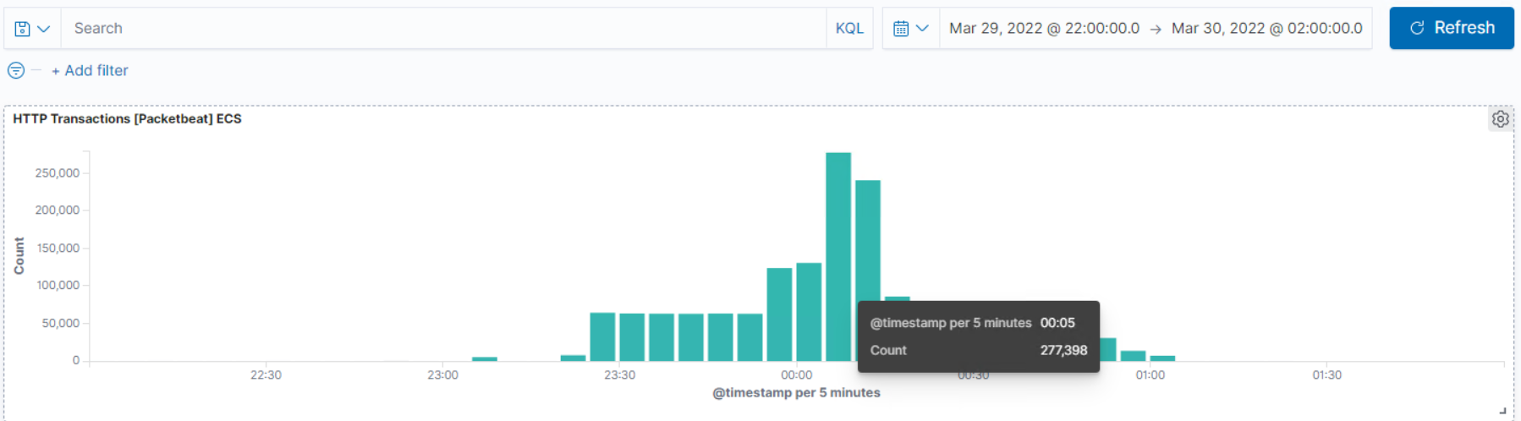
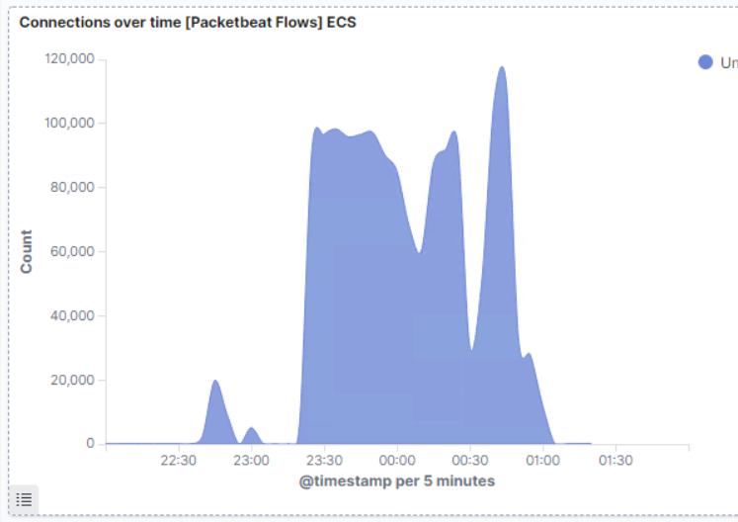
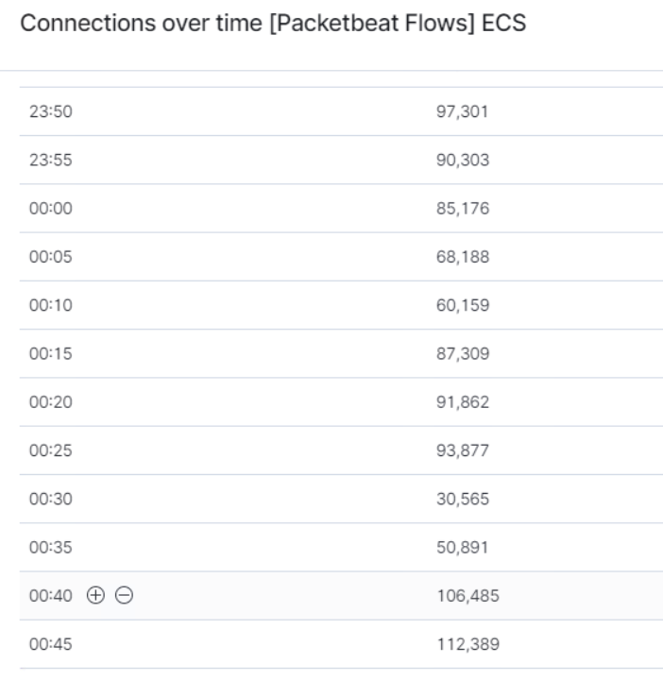
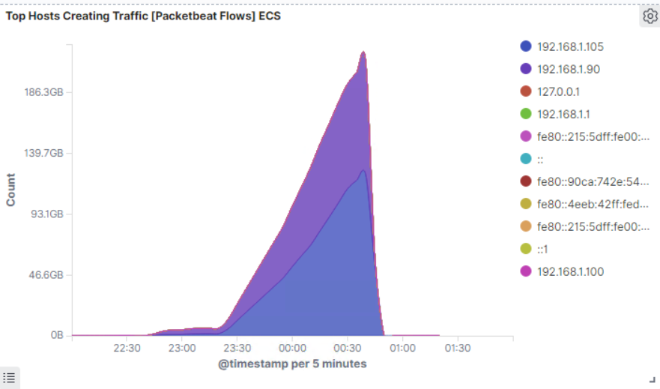
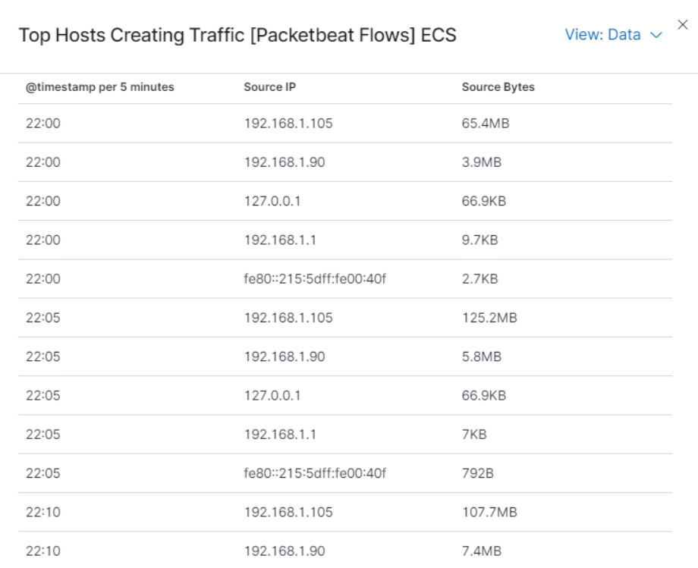
Analysis: Identifying the Port Scan
What time did the port scan occur? The scan occurred on 3/29/22 23:30 till 3/30/22 0:00
How many packets were sent, and from which IP? 192.168.1.90
What indicates that this was a port scan? A high amount of traffic from a single IP testing to see which ports are open
[Insert Here]
Include a screenshot of Kibana logs depicting the port scan.

Slide 13
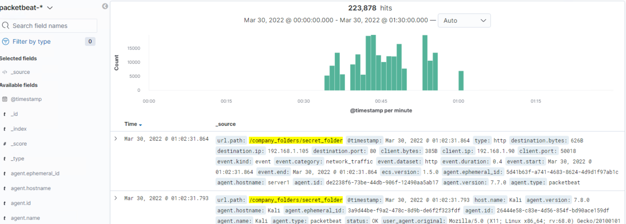
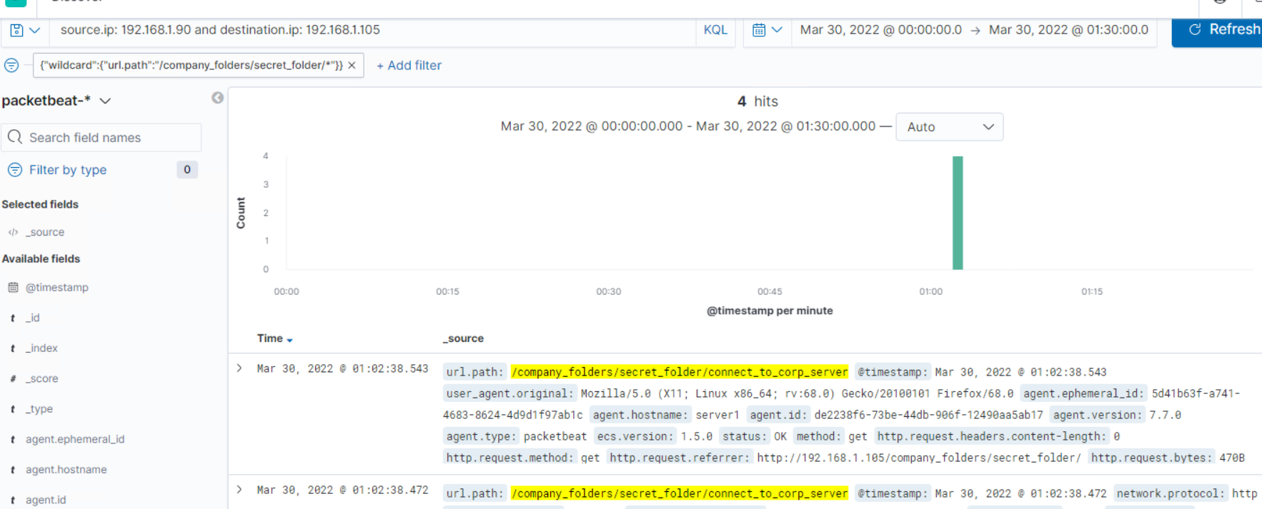
Analysis: Finding the Request for the Hidden Directory
What time did the request occur? The scan occurred on 3/30/22 0:00 till 3/30/22 01:20
How many requests were made? 223,878
Which files were requested? The connect to corp server file
What did they contain? It contained a hash password for the employee’s credentials (Ryan), which allowed access to the webdav site.

Slide 14
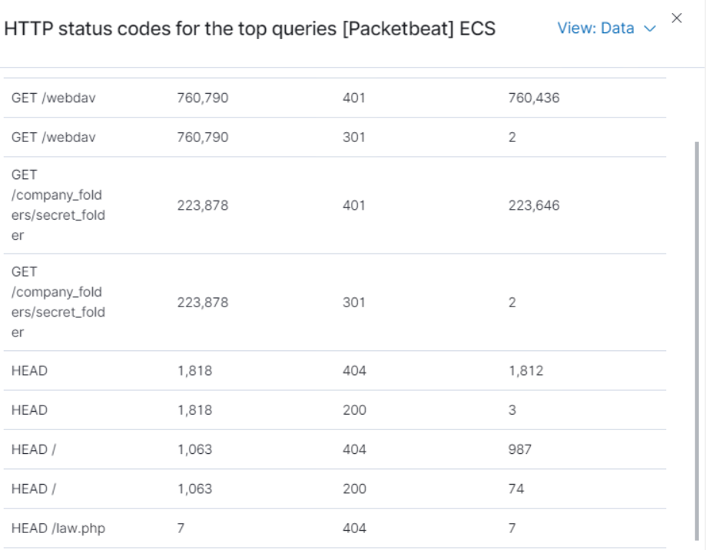
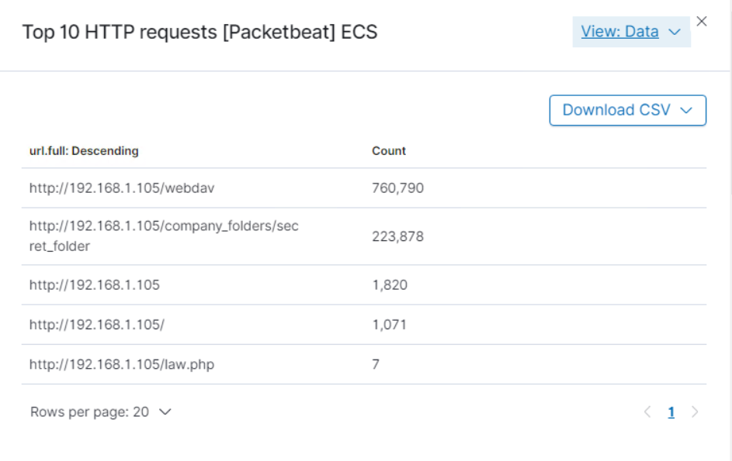
Analysis: Uncovering the Brute Force Attack
How many requests were made in the attack? 223,878
How many requests had been made before the attacker discovered the password? There were 2 requests made before the attacker found the password. This was spotted by the 301 http code which is a redirect

Slide 15
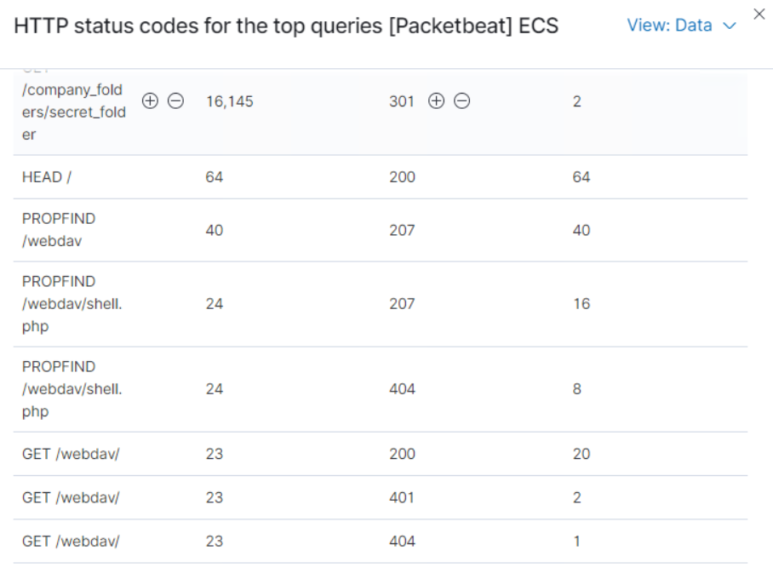
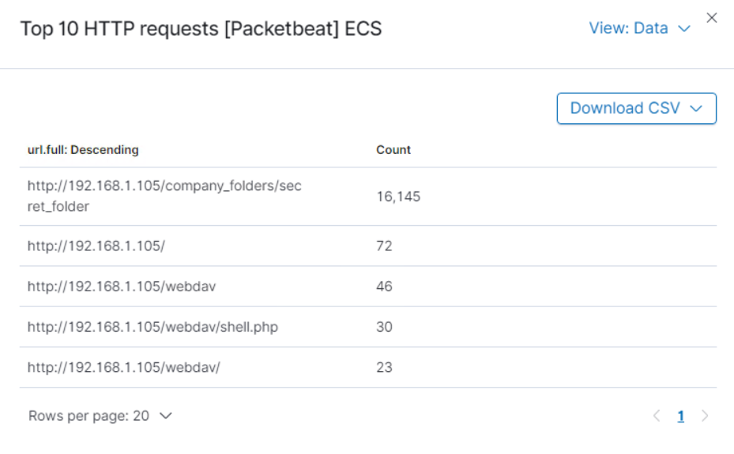
Analysis: Finding the WebDAV Connection
46 total requests were made for the WebDAV directory (192.168.1.105/webdav)
The file shell.php was requested.
Request methods include the following: GET, PUT, PROPFIND and OPTIONS

Slide 16
Blue Team
Proposed Alarms and Mitigation Strategies
16

Slide 17
Mitigation: Blocking the Port Scan
What kind of alarm can be set to detect future port scans?
An alert could be set to trigger when a large amount of traffic occurs in a short time from a single source IP that targets multiple ports.
What threshold would you set to activate this alarm?
A possible threshold for this alert could be if any single IP address requests more than 10 requests per second and more than 10 seconds or 100 consecutive ping (ICMP) requests.
What configurations can be set on the host to mitigate port scans?
1.Enable only the traffic needed to access internal hosts, deny everything else. Including the standard ports, such as TCP 80 for HTTP and ICMP for ping requests.
2. Configure the firewall to look for potentially malicious behavior over time and have rules in place to cut off attacks if a certain threshold is reached, such as 10 port scans in one minute or 100 consecutive ping (ICMP) requests.
Describe the solution. If possible, provide required command lines.
Create and enable firewall rules to block and filter the traffic. In addition, setup an IDS to create alerts so there can be a quick response to the situation.

Slide 18
Mitigation: Finding the Request for the Hidden Directory
What kind of alarm can be set to detect future unauthorized access?
An alarm should be configured to trigger if any request is made for the hidden directories from outside the company’s internal network. The hidden directories are for company use only and should not be accessible from outside the premises.
Additionally, an alarm should trigger if sequential requests for the directories are made from a single IP address.
What threshold would you set to activate this alarm?
The threshold for sequential requests from a single IP address should be set for greater than 0 requests made.
What configuration can be set on the host to block unwanted access?
1. Stronger usernames and password requirements for users that have access to the hidden directories.
2. Encrypt the contents of the hidden directories, and its contents.
3. Disable directories listing in the Apache.
Describe the solution. If possible, provide required command lines.
1. Create a whitelist for authorized IP addresses.
2. Make the folder private by changing permissions.
3. Allow connections to the hidden folder only through the VPN.

Slide 19
Mitigation: Preventing Brute Force Attacks
What configuration can be set on the host to block brute force attacks?
1. Restricting access to authentication URLs using IP filtering
2. Setting up a lockout after 3 consecutive failed attempts.
3. Enable FIDO based MFA for all users in the company.
Describe the solution. If possible, provide the required command line(s).
1. A requirement for brute force attacks is to send credentials to the same URL, if the url is put behind a VPN the attacker will not have access to the url.
2. Attackers will only be able to try a few passwords before the account is locked out.
3. MFA/FIDO requires an additional code or a physical device.
What kind of alarm can be set to detect future brute force attacks?
An alarm should be set to trigger if an unusual number of requests are issued to the server from a single IP address.
Also, an alert should be set if any user on the system has several consecutive failed authentication attempts.
What threshold would you set to activate this alarm?
The threshold should be set to anything over 25% more than the standard traffic to the site.

Slide 20
Mitigation: Detecting the WebDAV Connection
What kind of alarm can be set to detect future access to this directory?
An alarm should be set if any attempt to access the WebDav directory outside of the company’s is tried.
What threshold would you set to activate this alarm?
Anything over a single attempt should generate an alert to the security team.
What configuration can be set on the host to control access?
1. Make the WebDav folder read only, if it needs to be accessible by anyone.
2. Avoid storing instructions for accessing the server that can be accessed by a web browser.
3. Make sure software patches are up to date.
4. Configure WebDav correctly, and only allow uploads from trusted IPs.
Describe the solution. If possible, provide the required command line(s).
1. Setup Firewall rules for example:
iptables -A INPUT -s <Allowed IP> -p tcp -m
multiport! --dports 80,443 j ACCEPT
2. Put the device behind a vpn and encrypt the connection

Slide 21
Mitigation: Identifying Reverse Shell Uploads
What configuration can be set on the host to block file uploads?
1. All file uploads from outside of the company’s internal network should be blocked.
2. WebDav should be configured to filter out specific file types that cannot be uploaded or accessed
3. Store uploaded files in a location not accessible from the web.
4. Enable JEA and JIT on the share so access is timed and minimized
5. Have all the files run through an antivirus.
Describe the solution. If possible, provide the required command line.
By enabling file filtering, it can prevent extension spoofing
that is used to hide the file type. This in tandem with file execution blocking can prevent reverse shell attacks,
What kind of alarm can be set to detect future file uploads?
Alert if invalid file types are uploaded to the server.
Alert if any connections are made from the server to an external address.
Alert on any traffic that is not expected.
What threshold would you set to activate this alarm?
If any file uploads occur outside of the company network or trusted IPs to the server an alert should be triggered.

